Slide 1

离散数学
Discrete Mathematics
钟芳明
离散数学
Discrete Mathematics

Slide 2
Review
Predicate, variable, quantifier
Unary, n-ary, domain,
The universal quantifier,
The existential quantifier
Compound predicate formula
Free variable & bound variable
Equivalence & tautological implication with quantifiers

Slide 3
Translation of predicate formula
基本概念和表示
个体、谓词
量词
合式谓词公式
自由变元和约束变元
谓词逻辑的解释与翻译
谓词公式的解释
谓词公式的翻译
等价式与蕴涵式
德摩根律
量词辖域扩张及收缩律
量词分配律
等价式与蕴含式
There is an even number greater than 10.
P(x)：x is greater than 10.
Q(x)：x is an even number.
Symbolized:
Every student should exercise.
P(x)：x is a student.
Q(x)：x exercises.
Symbolized:
Incorrect：
Notes:
All people are students and do exercise.

Slide 4
Translation of predicate formula
基本概念和表示
个体、谓词
量词
合式谓词公式
自由变元和约束变元
谓词逻辑的解释与翻译
谓词公式的解释
谓词公式的翻译
等价式与蕴涵式
德摩根律
量词辖域扩张及收缩律
量词分配律
等价式与蕴含式
Some lions do not like drinking coffee.
P(x)：x is a lion.
Q(x)：x likes drinking coffee.
Symbolized:
Incorrect :
which is true when there is an animal (not lion), in that case, for such an animal x, P(x) →¬ Q(x) becomes either F→T or F→F, both of which are true, even every lion drinks coffee.
Notes:
Truth values are different
X is not a lion can be true.

Slide 5
Translation of predicate formula
基本概念和表示
个体、谓词
量词
合式谓词公式
自由变元和约束变元
谓词逻辑的解释与翻译
谓词公式的解释
谓词公式的翻译
等价式与蕴涵式
德摩根律
量词辖域扩张及收缩律
量词分配律
等价式与蕴含式
No matter black cats or white cats, the ones who catch mice are good cats.
P(x)：x is a black cat.
Q(x)：x is a white cat.
R(x)：x is a cat who catches mice.
G(x)：x is a good cat.
Symbolized:
Some people are allergic to certain foods.
A(x)：x is a people.
B(x)：x is food.
C(x, y)：x is allergic to y.
Symbolized:

Slide 6
Translation of predicate formula
基本概念和表示
个体、谓词
量词
合式谓词公式
自由变元和约束变元
谓词逻辑的解释与翻译
谓词公式的解释
谓词公式的翻译
等价式与蕴涵式
德摩根律
量词辖域扩张及收缩律
量词分配律
等价式与蕴含式
All persons are not as tall as the other.
P(x)：x is a person.
Q(x,y)：x is as tall as y.
R(x,y)：x is not same as y.
Symbolized:
It is not true that everyone is as tall as others.
Symbolized:
or：

Slide 7
Translation of predicate formula
基本概念和表示
个体、谓词
量词
合式谓词公式
自由变元和约束变元
谓词逻辑的解释与翻译
谓词公式的解释
谓词公式的翻译
等价式与蕴涵式
德摩根律
量词辖域扩张及收缩律
量词分配律
等价式与蕴含式
Symbolized: There is no hero who only loves Rivers and Mountains but does not love beauties.
Hero(x)：x is a Hero.
Love(x, y)：x loves y.
Symbolized ：
OR
7/30

Slide 8
Chapter 2 Predicate logic
2.4 Inference for Predicate Logic

Slide 9
Inference for Predicate Logic
推理规则
1. 约束变元的改名规则
2. 自由变元的代入规则
3. 命题变元的代换规则
4. 取代规则
5. 关于量词的增加和删除规则
US ES EG UG
推理实例
反证法
解决实际问题
Assume H₁,…, H_{m} ,C are predicate formulas. If (H₁∧ … ∧ H_{m} ) ⇒C，H₁,…, H_{m} are collectively implicate C, namely H₁,…, H_{m} ⇒C

Slide 10
Rules of Inference for Predicate Logic
Rule 1: Renaming rules for bound variables
Rule 2: Substitution rules of free variables
Rule 3: Substitution rules for propositional variables
Rule 4: Replacement rules
Rule 5: Rules of Inference for Quantifiers --- Addition and Elimination of Quantifiers
推理规则
1. 约束变元的改名规则
2. 自由变元的代入规则
3. 命题变元的代换规则
4. 取代规则
5. 关于量词的增加和删除规则
US ES EG UG
推理实例
反证法
解决实际问题

Slide 11
Rule 1: Renaming rules for bound variables
推理规则
1. 约束变元的改名规则
2. 自由变元的代入规则
3. 命题变元的代换规则
4. 取代规则
5. 关于量词的增加和删除规则
US ES EG UG
推理实例
反证法
解决实际问题
The name of the bound variable is changed so that a variable has only one form in a formula. The rules are as follows:
The variable that need be renamed should in the scope of one quantifier and change all bound variable in this scope with keeping the other part constant.
The new variable symbol should be never used in this scope. It would be best that the symbol is never used in formula.

Slide 12
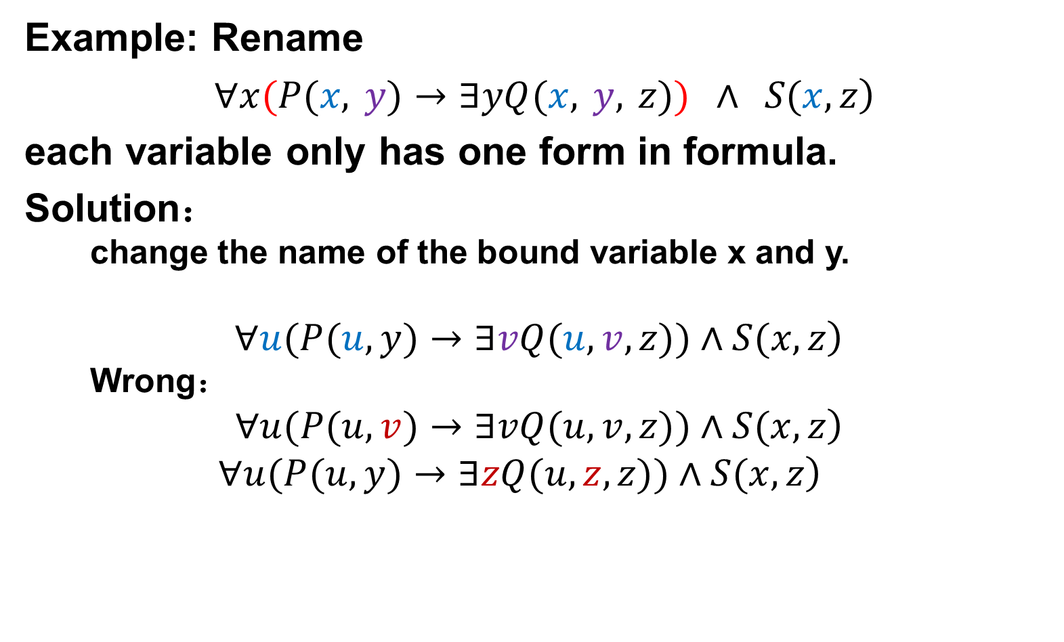
Rule 1: Renaming rules for bound variables
推理规则
1. 约束变元的改名规则
2. 自由变元的代入规则
3. 命题变元的代换规则
4. 取代规则
5. 关于量词的增加和删除规则
US ES EG UG
推理实例
反证法
解决实际问题
Example: Rename
$\left.∀x(P(x, y)→∃yQ(x, y, z)) ∧ S(x,z\right)$
each variable only has one form in formula.
Solution：
change the name of the bound variable x and y.
$$\left.∀u(P(u,y)→∃vQ(u,v,z))∧S(x,z\right)$$
Wrong：
$$\left.∀u(P(u,v)→∃vQ(u,v,z))∧S(x,z\right)$$
$$\left.∀u(P(u,y)→∃zQ(u,z,z))∧S(x,z\right)$$

Slide 13
Rule 1: Renaming rules for bound variables
推理规则
1. 约束变元的改名规则
2. 自由变元的代入规则
3. 命题变元的代换规则
4. 取代规则
5. 关于量词的增加和删除规则
US ES EG UG
推理实例
反证法
解决实际问题
Example 1: For formula
$(∀x) (P(x) →Q(x))∨(∀x) (P(x) →R(x))$
Clearly, rename the bound variable x:
$$(∀x) (P(x) →Q(x))∨(∀y) (P(y) →R(y))$$
Example 2 : For formula
$(∀x) (P(x) →R(x,y)) ∧Q(x,y)$
Rename the bound variable x:
$$(∀z) (P(z) →R(z,y)) ∧Q(x,y)$$
Wrong：
$(∀z) (P(z) →R(x,y)) ∧Q(x,y)$
$(∀y) (P(y) →R(y,y)) ∧Q(x,y)$

Slide 14
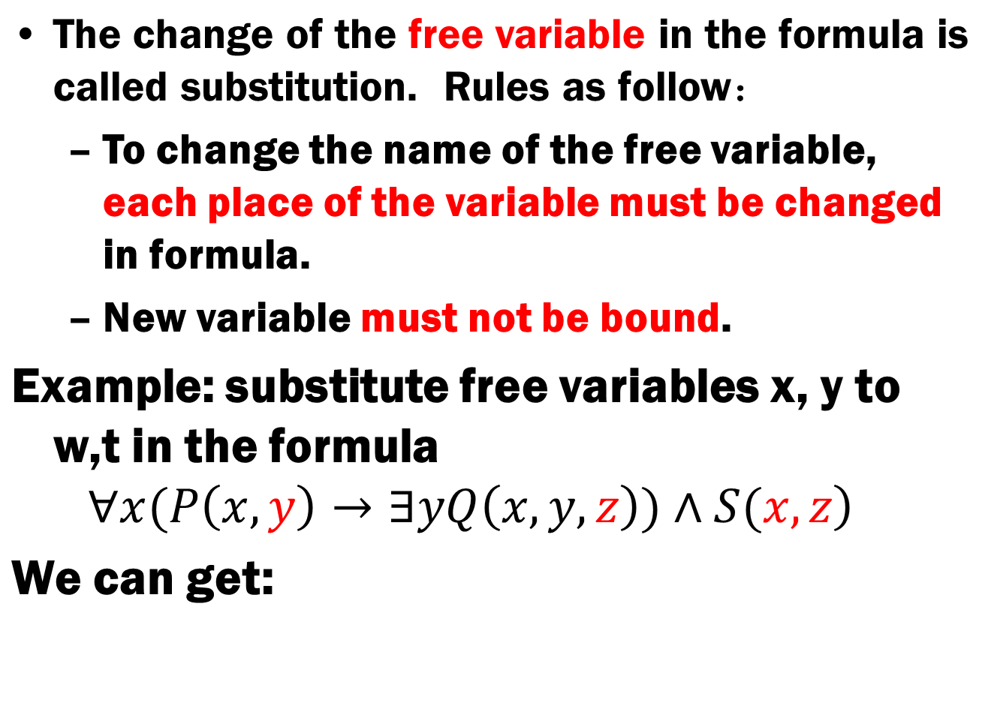
Rule 2: Substitution rules of free variables
推理规则
1. 约束变元的改名规则
2. 自由变元的代入规则
3. 命题变元的代换规则
4. 取代规则
5. 关于量词的增加和删除规则
US ES EG UG
推理实例
反证法
解决实际问题

Slide 15
Rule 3: Substitution rules for propositional variables
推理规则
1. 约束变元的改名规则
2. 自由变元的代入规则
3. 命题变元的代换规则
4. 取代规则
5. 关于量词的增加和删除规则
US ES EG UG
推理实例
反证法
解决实际问题
Substituting all propositional variable P_{i} in the tautological formula B by a predicate A_{i}, the resulting new formula B’ is still tautological (but there should be not a bound variable of B in the predicate A_{i，} A_{i}的个体变元中不应有B中的约束变元出现), and B⇒B’.

Slide 16
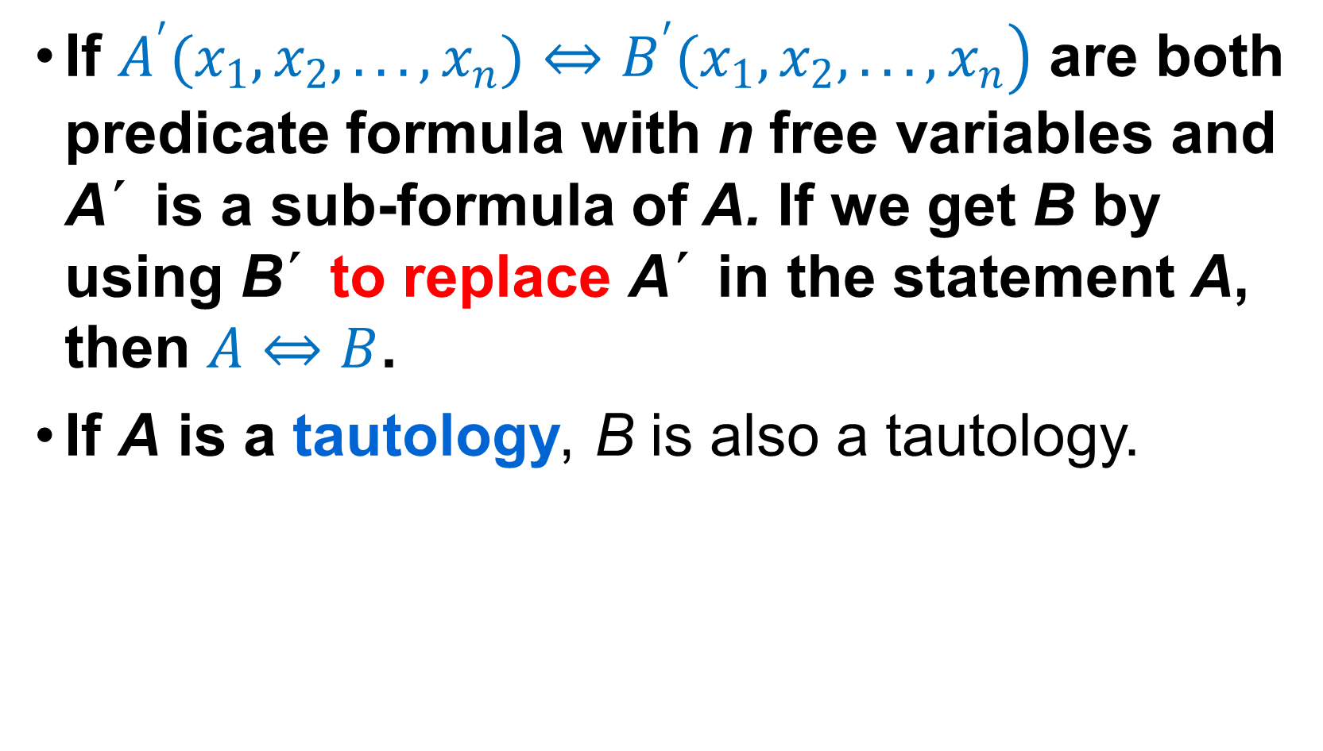
Rule 4: Replacement rules
推理规则
1. 约束变元的改名规则
2. 自由变元的代入规则
3. 命题变元的代换规则
4. 取代规则
5. 关于量词的增加和删除规则
US ES EG UG
推理实例
反证法
解决实际问题
If $\left.A^{′}(x_{1},x_{2},...,x_{n})⇔B^{′}(x_{1},x_{2},...,x_{n}\right)$ are both predicate formula with n free variables and A´ is a sub-formula of A. If we get B by using B´ to replace A´ in the statement A, then $A⇔B$.
If A is a tautology, B is also a tautology.

Slide 17
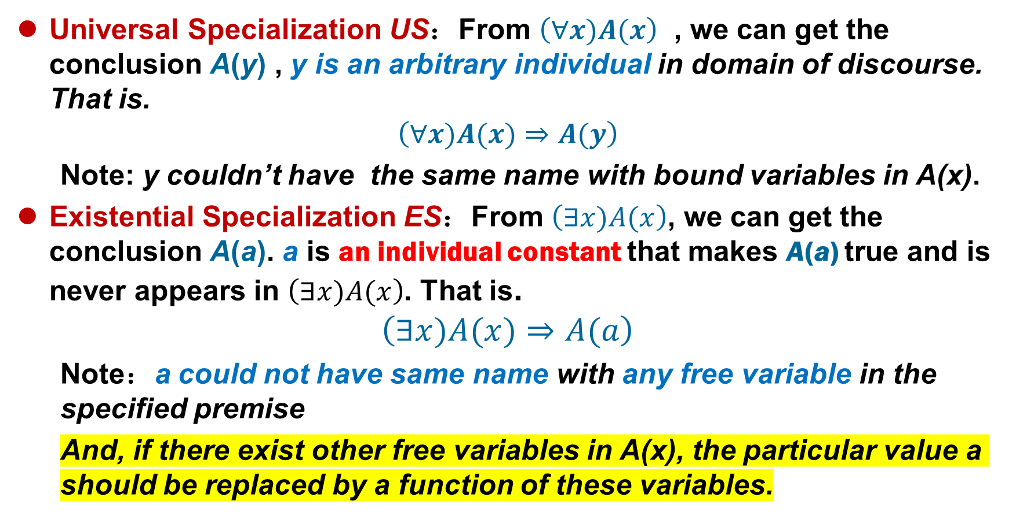
Rule 5:Addition and Elimination of Quantifiers
推理规则
1. 约束变元的改名规则
2. 自由变元的代入规则
3. 命题变元的代换规则
4. 取代规则
5. 关于量词的增加和删除规则
US ES EG UG
推理实例
反证法
解决实际问题
Universal Specialization US：From $\left(∀x)A(x\right)$ , we can get the conclusion A(y) , y is an arbitrary individual in domain of discourse. That is.
$$\left(∀x)A(x)⇒A(y\right)$$
Note: y couldn’t have the same name with bound variables in A(x).
Existential Specialization ES：From $\left(∃x)A(x\right)$, we can get the conclusion A(a). a is an individual constant that makes A(a) true and is never appears in $\left(∃x)A(x\right)$. That is.
$$\left(∃x)A(x)⇒A(a\right)$$
Note：a could not have same name with any free variable in the specified premise
And, if there exist other free variables in A(x), the particular value a should be replaced by a function of these variables.
Notes:
必须是使A（x）为真的那个，所以要根据其他自由变元的变化而变化。

Slide 18
Rule 5:Addition and Elimination of Quantifiers
推理规则
1. 约束变元的改名规则
2. 自由变元的代入规则
3. 命题变元的代换规则
4. 取代规则
5. 关于量词的增加和删除规则
US ES EG UG
推理实例
反证法
解决实际问题
Example
Assume in the domain of real number，the statement “There is no largest real number” can be translated to：(∀x)(∃y)G(x, y), where G(x, y) : y > x . Is the following derivation correct? Why?
(1) (∀x)(∃y)G(x, y) P
(2) (∃y)G(z, y) US, (1)
(3) G(z, c) ES, (2)
SOLN Above derivation is incorrect. The correct one should be：
(1) (∀x)(∃y)G(x, y) P
(2) (∃y)G(z, y) US, (1)
(3) G(z, f(z)) ES, (2)
Notes:
必须是使A（x）为真的那个，所以要根据其他自由变元的变化而变化。

Slide 19
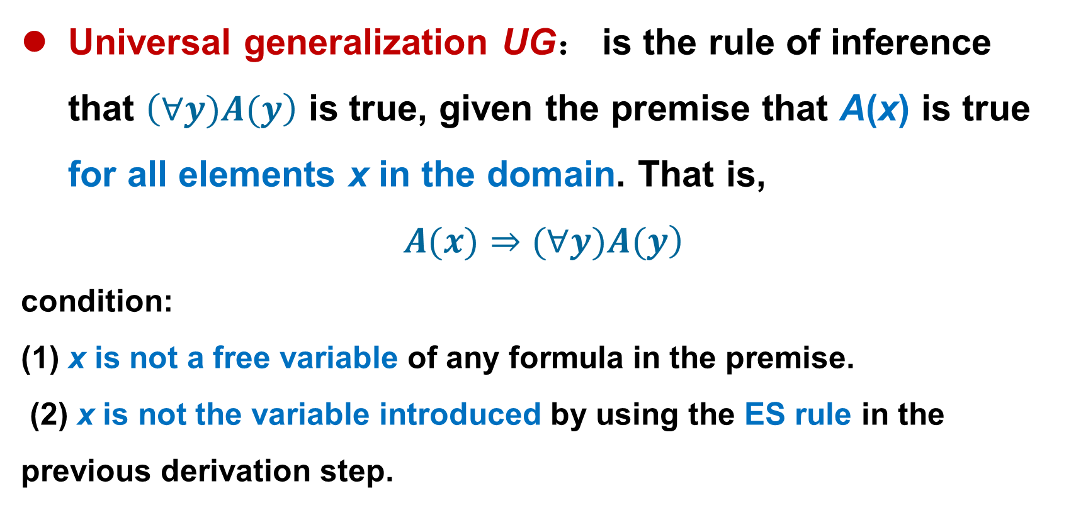
Rule 5:Addition and Elimination of Quantifiers
推理规则
1. 约束变元的改名规则
2. 自由变元的代入规则
3. 命题变元的代换规则
4. 取代规则
5. 关于量词的增加和删除规则
US ES EG UG
推理实例
反证法
解决实际问题
Universal generalization UG： is the rule of inference that $\left(∀y)A(y\right)$ is true, given the premise that A(x) is true for all elements x in the domain. That is,
$$\left.A(x)⇒(∀y)A(y\right)$$
condition:
(1) x is not a free variable of any formula in the premise.
(2) x is not the variable introduced by using the ES rule in the previous derivation step.

Slide 20
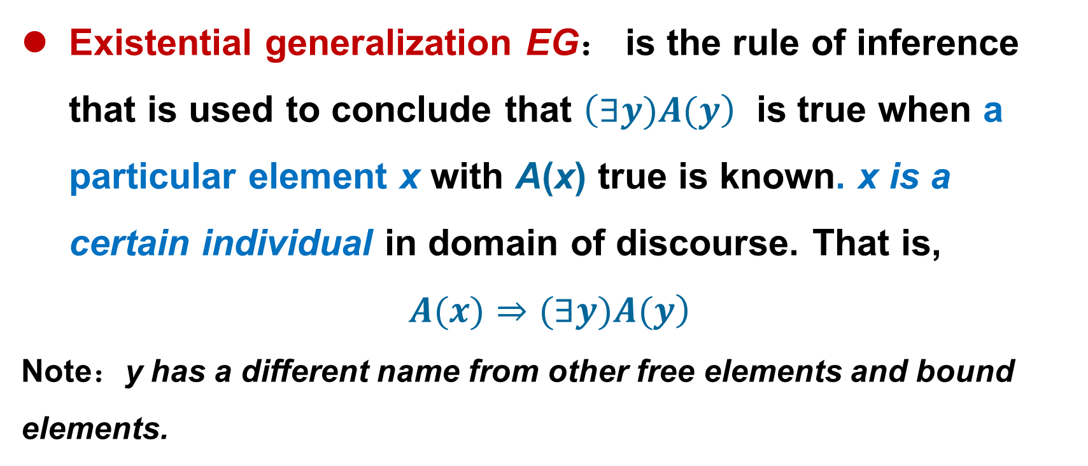
Rule 5:Addition and Elimination of Quantifiers
推理规则
1. 约束变元的改名规则
2. 自由变元的代入规则
3. 命题变元的代换规则
4. 取代规则
5. 关于量词的增加和删除规则
US ES EG UG
推理实例
反证法
解决实际问题
Existential generalization EG： is the rule of inference that is used to conclude that $\left(∃y)A(y\right)$ is true when a particular element x with A(x) true is known. x is a certain individual in domain of discourse. That is,
$$\left.A(x)⇒(∃y)A(y\right)$$
Note：y has a different name from other free elements and bound elements.

Slide 21
Rule 5:Addition and Elimination of Quantifiers
推理规则
1. 约束变元的改名规则
2. 自由变元的代入规则
3. 命题变元的代换规则
4. 取代规则
5. 关于量词的增加和删除规则
US ES EG UG
推理实例
反证法
解决实际问题
UG-------Universal Generalization
EG-------Existential Generalization
US-------Universal Specialization
ES------- Existential Specialization

Slide 22
Inference of predicate logic
推理规则
1. 约束变元的改名规则
2. 自由变元的代入规则
3. 命题变元的代换规则
4. 取代规则
5. 关于量词的增加和删除规则
US ES EG UG
推理实例
反证法
解决实际问题
Extension of propositional reasoning rules for predicate logic
P rule
T rule
CP rule
F rule
Everything is ready for proceeding

Slide 23
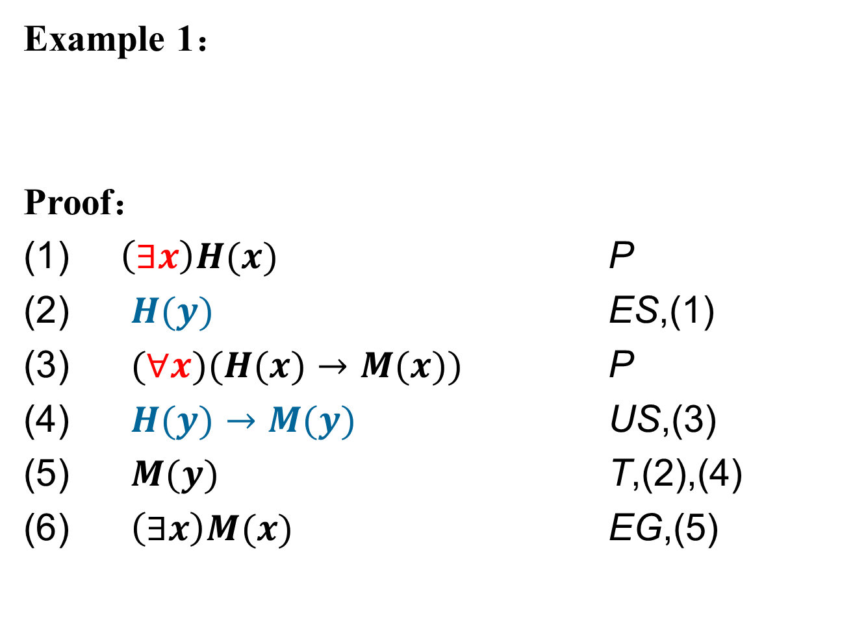
Inference of predicate logic
推理规则
1. 约束变元的改名规则
2. 自由变元的代入规则
3. 命题变元的代换规则
4. 取代规则
5. 关于量词的增加和删除规则
US ES EG UG
推理实例
反证法
解决实际问题
Example 1：
Proof：
$\left(∃x\right)H(x)$ P
$H(y)$ ES,(1)
$(∀x)(H(x)→M(x))$ P
$H(y)→M(y)$ US,(3)
$M(y)$ T,(2),(4)
$\left(∃x\right)M(x)$ EG,(5)
Applying the Existential Specification rule before Universal Specification.

Slide 24
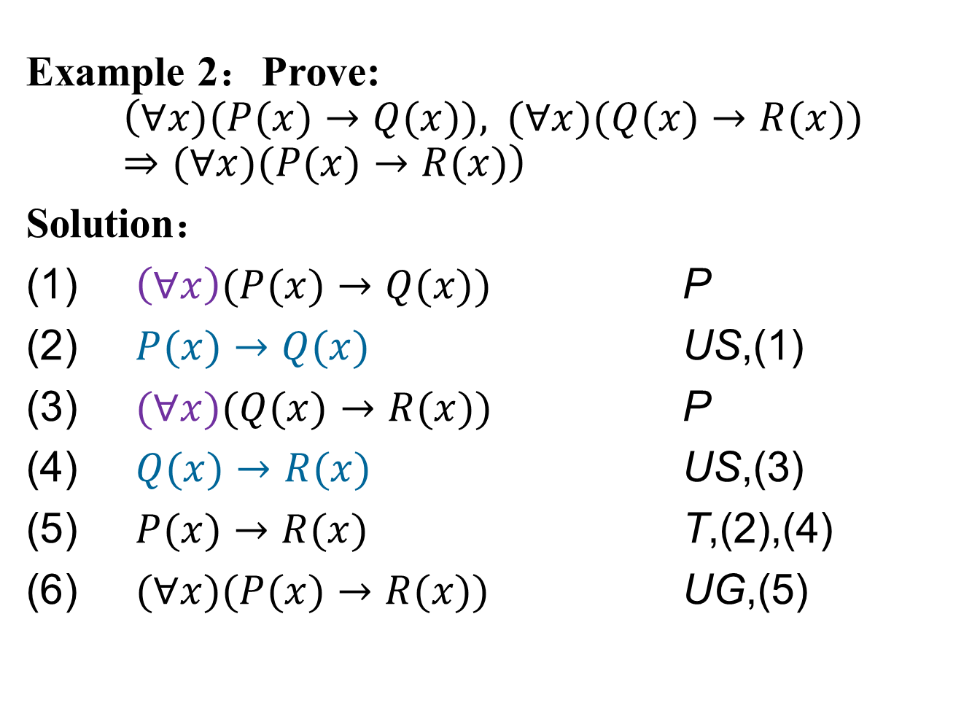
Inference of predicate logic
推理规则
1. 约束变元的改名规则
2. 自由变元的代入规则
3. 命题变元的代换规则
4. 取代规则
5. 关于量词的增加和删除规则
US ES EG UG
推理实例
反证法
解决实际问题
Example 2：Prove:
$$\left(∀x)(P(x)→Q(x)), (∀x)(Q(x)→R(x))⇒(∀x)(P(x)→R(x)\right)$$
Solution：
$\left(∀x\right)(P(x)→Q(x))$ P
$P(x)→Q(x)$ US,(1)
$(∀x)(Q(x)→R(x))$ P
$Q(x)→R(x)$ US,(3)
$P(x)→R(x)$ T,(2),(4)
$(∀x)(P(x)→R(x))$ UG,(5)

Slide 25
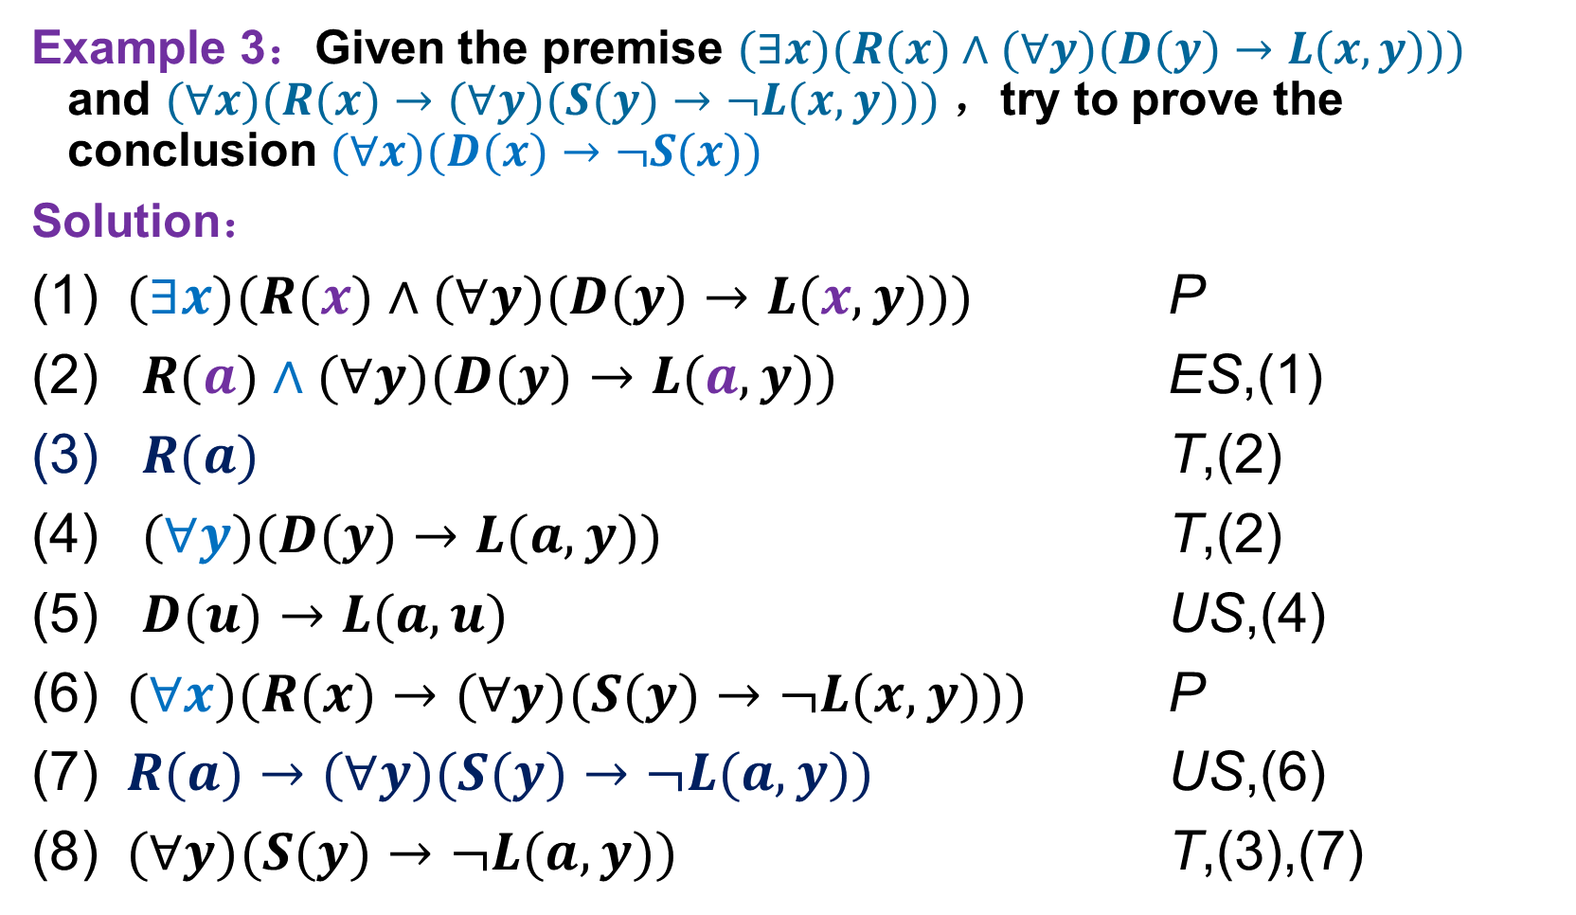
Inference of predicate logic
推理规则
1. 约束变元的改名规则
2. 自由变元的代入规则
3. 命题变元的代换规则
4. 取代规则
5. 关于量词的增加和删除规则
US ES EG UG
推理实例
反证法
解决实际问题
Example 3：Given the premise $(∃x)(R(x)∧(∀y)(D(y)→L(x,y)))$ and $(∀x)(R(x)→(∀y)(S(y)→¬L(x,y)))$ ，try to prove the conclusion $(∀x)(D(x)→¬S(x))$
Solution：
$(∃x)(R(x)∧(∀y)(D(y)→L(x,y)))$ P
$R(a)∧(∀y)(D(y)→L(a,y))$ ES,(1)
$R(a)$ T,(2)
$(∀y)(D(y)→L(a,y))$ T,(2)
$D(u)→L(a,u)$ US,(4)
$(∀x)(R(x)→(∀y)(S(y)→¬L(x,y)))$ P
$R(a)→(∀y)(S(y)→¬L(a,y))$ US,(6)
$(∀y)(S(y)→¬L(a,y))$ T,(3),(7)

Slide 26
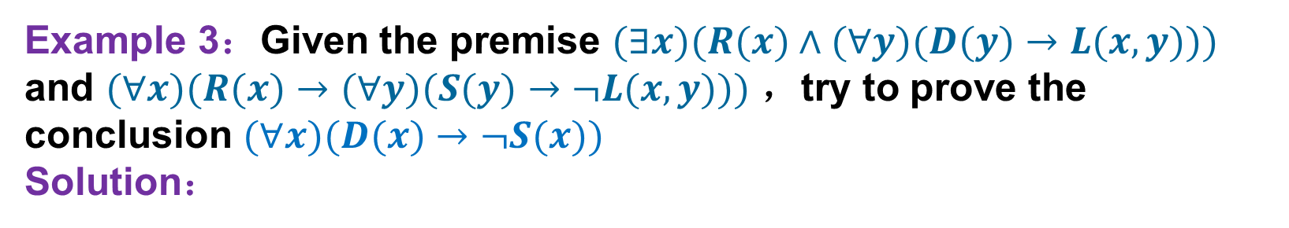
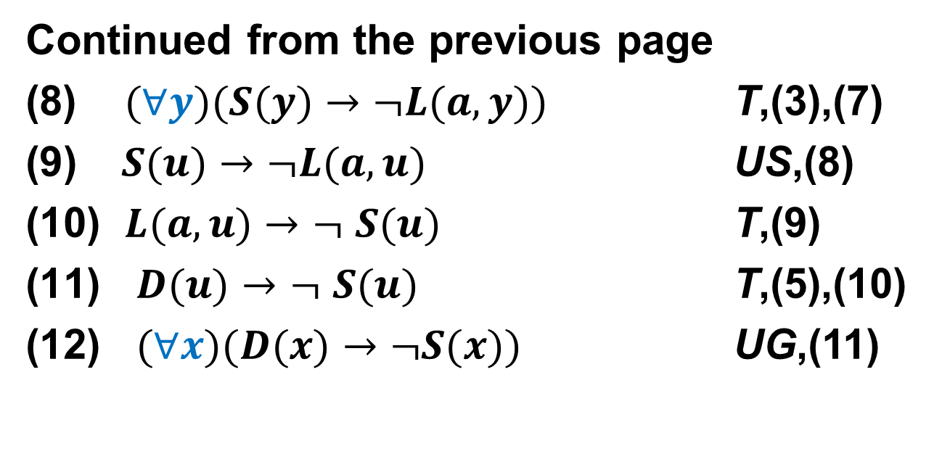
Inference of predicate logic
推理规则
1. 约束变元的改名规则
2. 自由变元的代入规则
3. 命题变元的代换规则
4. 取代规则
5. 关于量词的增加和删除规则
US ES EG UG
推理实例
反证法
解决实际问题
Example 3：Given the premise $(∃x)(R(x)∧(∀y)(D(y)→L(x,y)))$ and $(∀x)(R(x)→(∀y)(S(y)→¬L(x,y)))$ ，try to prove the conclusion $(∀x)(D(x)→¬S(x))$
Solution：
Continued from the previous page
(8) $(∀y)(S(y)→¬L(a,y))$ T,(3),(7)
$S(u)→¬L(a,u)$ US,(8)
$L(a,u)$ $→$ $¬$ $S(u)$ T,(9)
$D(u)→$ $¬$ $S(u)$ T,(5),(10)
$(∀x)(D(x)→¬S(x))$ UG,(11)

Slide 27
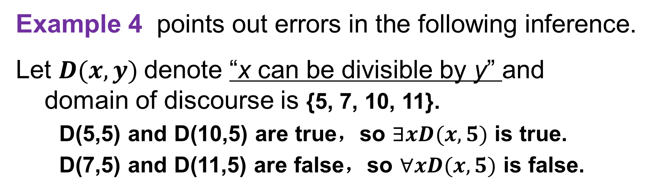
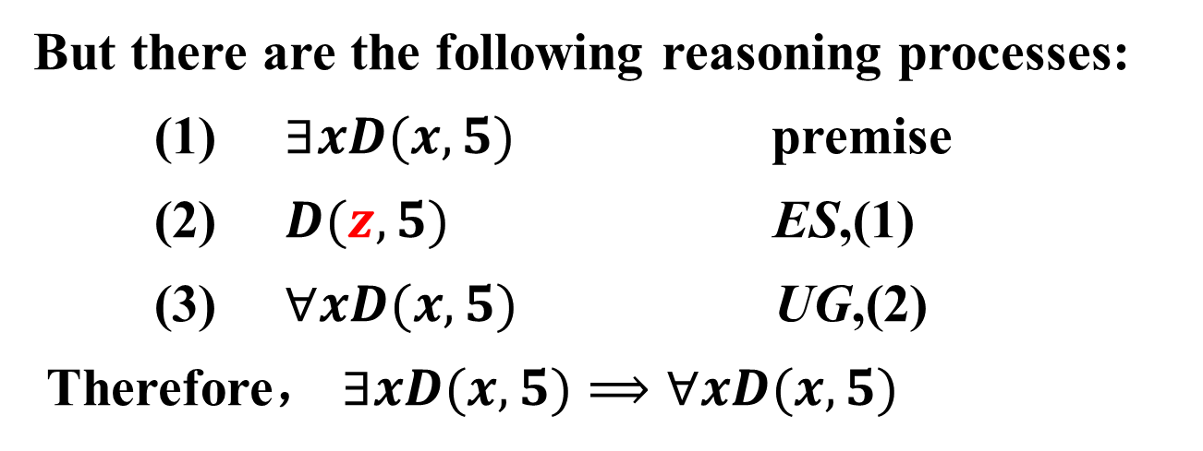
Inference of predicate logic
推理规则
1. 约束变元的改名规则
2. 自由变元的代入规则
3. 命题变元的代换规则
4. 取代规则
5. 关于量词的增加和删除规则
US ES EG UG
推理实例
反证法
解决实际问题
Example 4 points out errors in the following inference.
Let $D(x,y)$denote “x can be divisible by y” and domain of discourse is {5, 7, 10, 11}.
D(5,5) and D(10,5) are true，so $∃xD(x,5)$ is true.
D(7,5) and D(11,5) are false，so $∀xD(x,5)$ is false.
But there are the following reasoning processes:
(1) $∃xD(x,5)$ premise
(2) $D(z,5)$ ES,(1)
(3) $∀xD(x,5)$ UG,(2)
Therefore， $∃xD(x,5)⟹∀xD(x,5)$
Rule UG cannot be applied to the variable introduced by rule ES
wrong！

Slide 28
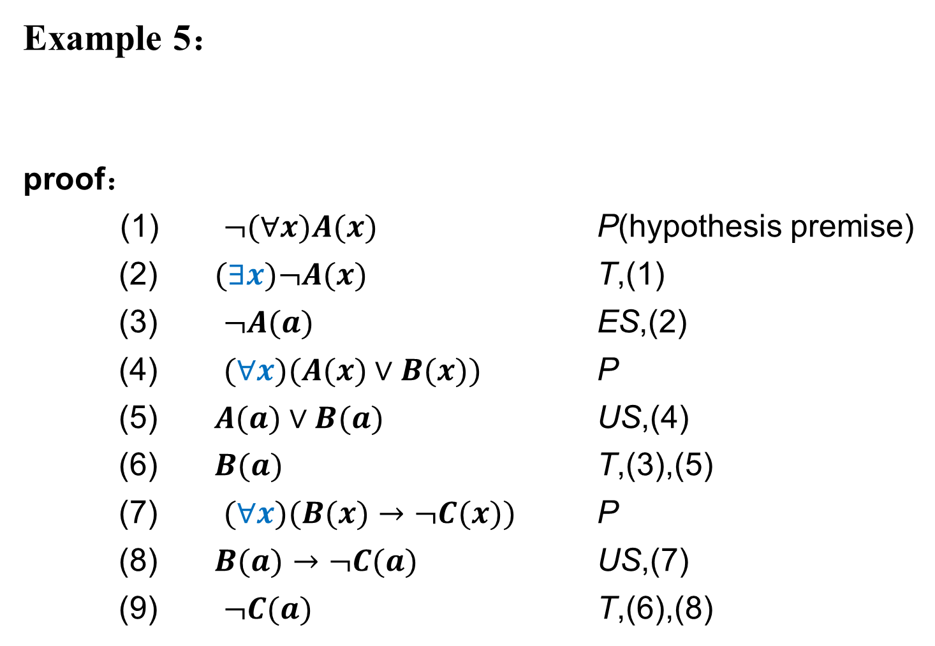
Proof by Contradiction
推理规则
1. 约束变元的改名规则
2. 自由变元的代入规则
3. 命题变元的代换规则
4. 取代规则
5. 关于量词的增加和删除规则
US ES EG UG
推理实例
反证法
解决实际问题
Example 5：
proof：
(1) $¬(∀x)A(x)$ P(hypothesis premise)
(2) $(∃x)¬A(x)$ T,(1)
(3) $¬A(a)$ ES,(2)
(4) $(∀x)(A(x)∨B(x))$ P
(5) $A(a)∨B(a)$ US,(4)
(6) $B(a)$ T,(3),(5)
(7) $(∀x)(B(x)→¬C(x))$ P
(8) $B(a)→¬C(a)$ US,(7)
(9) $¬C(a)$ T,(6),(8)

Slide 29
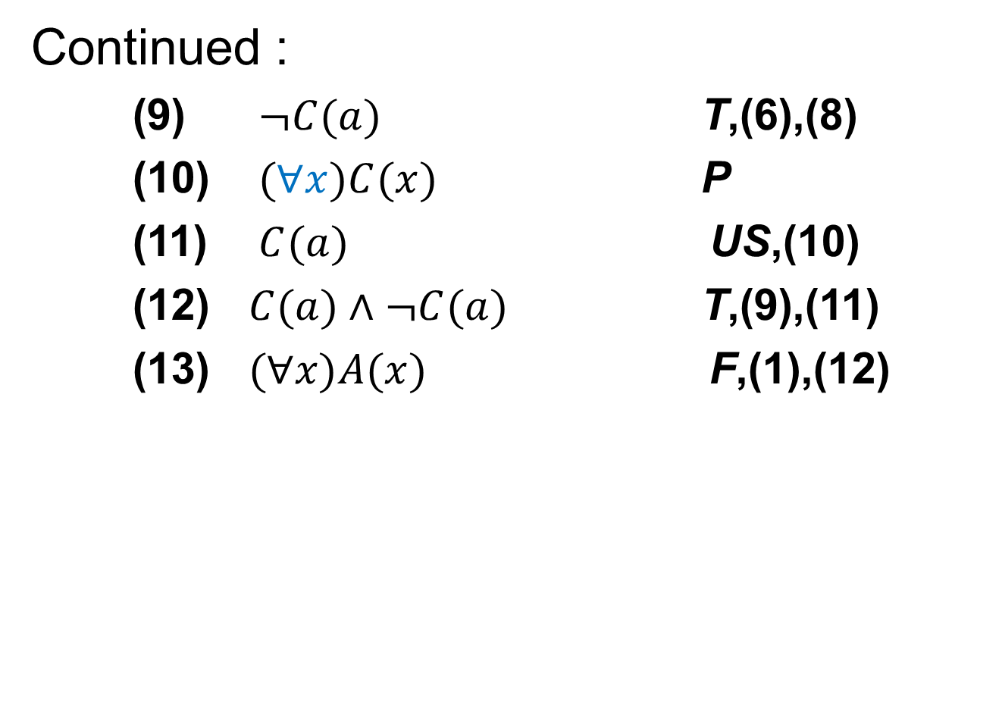
Proof by Contradiction
推理规则
1. 约束变元的改名规则
2. 自由变元的代入规则
3. 命题变元的代换规则
4. 取代规则
5. 关于量词的增加和删除规则
US ES EG UG
推理实例
反证法
解决实际问题
Continued :
(9) $¬C(a)$ T,(6),(8)
(10) $(∀x)C(x)$ P
(11) $C(a)$ US,(10)
(12) $C(a)∧¬C(a)$ T,(9),(11)
(13) $(∀x)A(x)$ F,(1),(12)

Slide 30
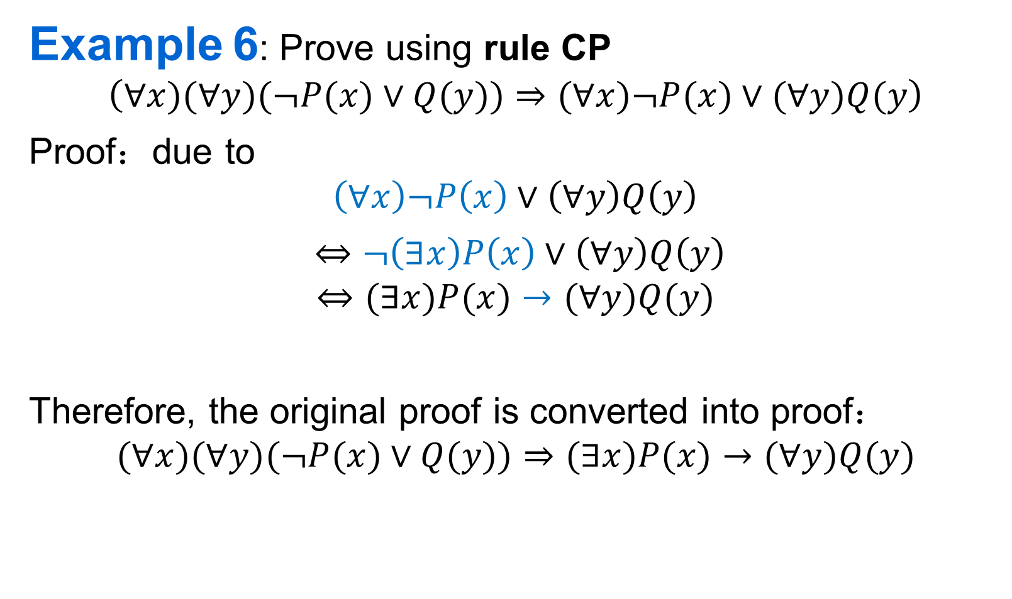
Inference by Conditional Proof
推理规则
1. 约束变元的改名规则
2. 自由变元的代入规则
3. 命题变元的代换规则
4. 取代规则
5. 关于量词的增加和删除规则
US ES EG UG
推理实例
反证法
解决实际问题
Example 6: Prove using rule CP
$$\left(∀x)(∀y)(¬P(x)∨Q(y))⇒(∀x)¬P(x)∨(∀y)Q(y\right)$$
Proof：due to
$$\left(∀x\right)¬P\left(x\right)∨\left(∀y\right)Q\left(y\right)$$
$⇔$ $¬\left(∃x\right)P\left(x\right)∨\left(∀y\right)Q\left(y\right)$
$$⇔(∃x)P(x)→(∀y)Q(y)$$
Therefore, the original proof is converted into proof：
$$(∀x)(∀y)(¬P(x)∨Q(y))⇒(∃x)P(x)→(∀y)Q(y)$$

Slide 31
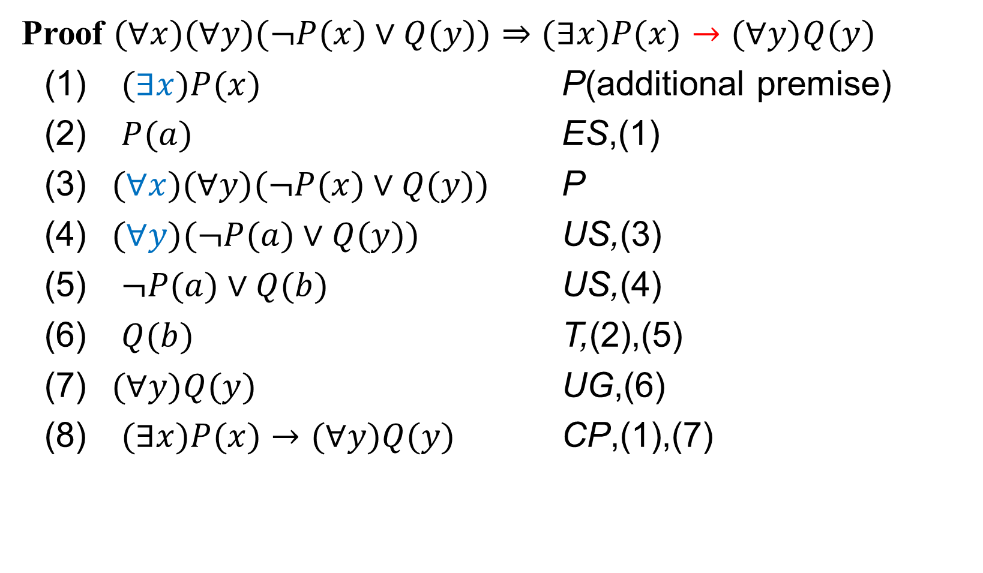
Inference by Conditional Proof
推理规则
1. 约束变元的改名规则
2. 自由变元的代入规则
3. 命题变元的代换规则
4. 取代规则
5. 关于量词的增加和删除规则
US ES EG UG
推理实例
反证法
解决实际问题
Proof $(∀x)(∀y)(¬P(x)∨Q(y))⇒(∃x)P(x)→(∀y)Q(y)$
(1) $(∃x)P(x)$ P(additional premise)
(2) $P(a)$ ES,(1)
(3) $(∀x)(∀y)(¬P(x)∨Q(y))$ P
(4) $(∀y)(¬P(a)∨Q(y))$ US,(3)
(5) $¬P(a)∨Q(b)$ US,(4)
(6) $Q(b)$ T,(2),(5)
(7) $(∀y)Q(y)$ UG,(6)
(8) $(∃x)P(x)→(∀y)Q(y)$ CP,(1),(7)

Slide 32
Inference of predicate logic
推理规则
1. 约束变元的改名规则
2. 自由变元的代入规则
3. 命题变元的代换规则
4. 取代规则
5. 关于量词的增加和删除规则
US ES EG UG
推理实例
反证法
解决实际问题
Example 7: For the use of nested quantifiers, observe the following reasoning process.
Proof:
(1) (∀x)(∃y)P(x, y) Premise
(2) (∃y)P(z, y) US, (1)
(3) P(z, d) ES, (2)
(4) (∀x)P(x, d) UG, (3)
(5) (∃y)(∀x)P(x, y) EG, (4)
We can get a wrong conclusion that (∀x) and (∃y) can be exchanged.
wrong！
wrong！
Note: There are two possibilities for z in equation (2).
1) If z is a free variable, then the value of y varies with z, so the y cannot be changed to the individual constant d with the ES rule. It should be P(z, f(z)).
2) If z is an individual constant, formula (3) is correct, but at this time it cannot be obtained with rule UG in (4)

Slide 33
Predicate logic to solve real problems
推理规则
1. 约束变元的改名规则
2. 自由变元的代入规则
3. 命题变元的代换规则
4. 取代规则
5. 关于量词的增加和删除规则
US ES EG UG
推理实例
反证法
解决实际问题
Steps：
Define a set of predicates based on the needs of the problem
Symbolize actual problems
Effective reasoning using inference rules
Note：
Symbolic principle ：The universal quantifier corresponds to the logical connection → , and the existential quantifier corresponds to the logical connection Λ
We introduce the premise with existential quantifier to ensure validity of the "ES" rule

Slide 34
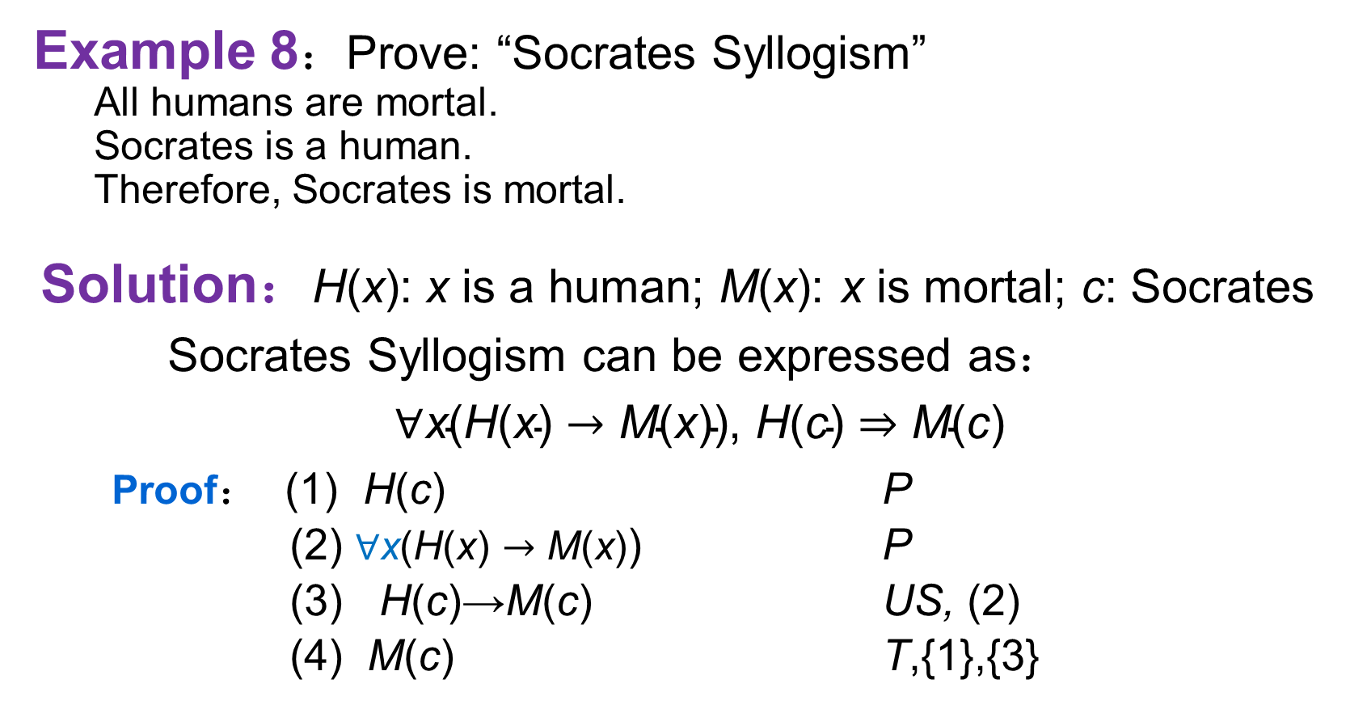
Predicate logic to solve real problems
推理规则
1. 约束变元的改名规则
2. 自由变元的代入规则
3. 命题变元的代换规则
4. 取代规则
5. 关于量词的增加和删除规则
US ES EG UG
推理实例
反证法
解决实际问题
Example 8：Prove: “Socrates Syllogism”
All humans are mortal.
Socrates is a human.
Therefore, Socrates is mortal.
Solution：H(x): x is a human; M(x): x is mortal; c: Socrates
Socrates Syllogism can be expressed as：
$∀\text{x}\text{(}\text{H}\text{(}\text{x}\text{)}→\text{M}\text{(}\text{x}\text{)),} \text{H}\text{(}\text{c}\text{)}⇒\text{M}\text{(}\text{c}\text{)}$
Proof： (1) H(c) P
(2) $∀\text{x}\text{(}\text{H}\text{(}\text{x}\text{)}→\text{M}\text{(}\text{x}\text{)}$) P
(3) H(c)→M(c) US, (2)
(4) M(c) T,{1},{3}

Slide 35
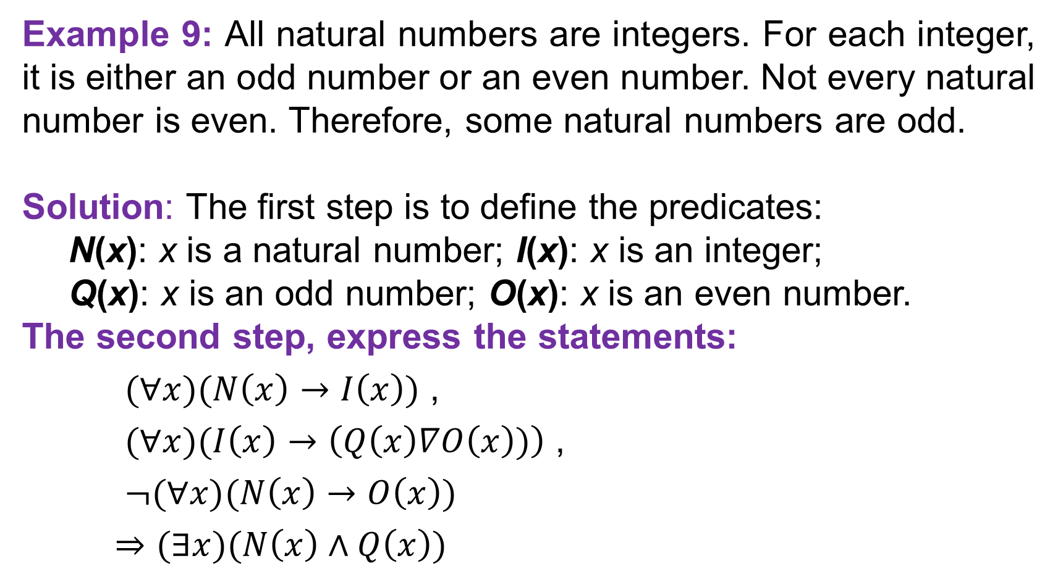
Predicate logic to solve real problems
推理规则
1. 约束变元的改名规则
2. 自由变元的代入规则
3. 命题变元的代换规则
4. 取代规则
5. 关于量词的增加和删除规则
US ES EG UG
推理实例
反证法
解决实际问题
Example 9: All natural numbers are integers. For each integer, it is either an odd number or an even number. Not every natural number is even. Therefore, some natural numbers are odd.
Solution: The first step is to define the predicates:
N(x): x is a natural number; I(x): x is an integer;
Q(x): x is an odd number; O(x): x is an even number.
The second step, express the statements:
$(∀x)(N\left(x\right)→I\left(x\right))$ ,
$(∀x)(I\left(x\right)→\left(Q\left(x\right)∇O\left(x\right))\right)$ ,
$¬(∀x)(N\left(x\right)→O\left(x\right))$
$⇒(∃x)(N\left(x\right)∧Q\left(x\right))$

Slide 36
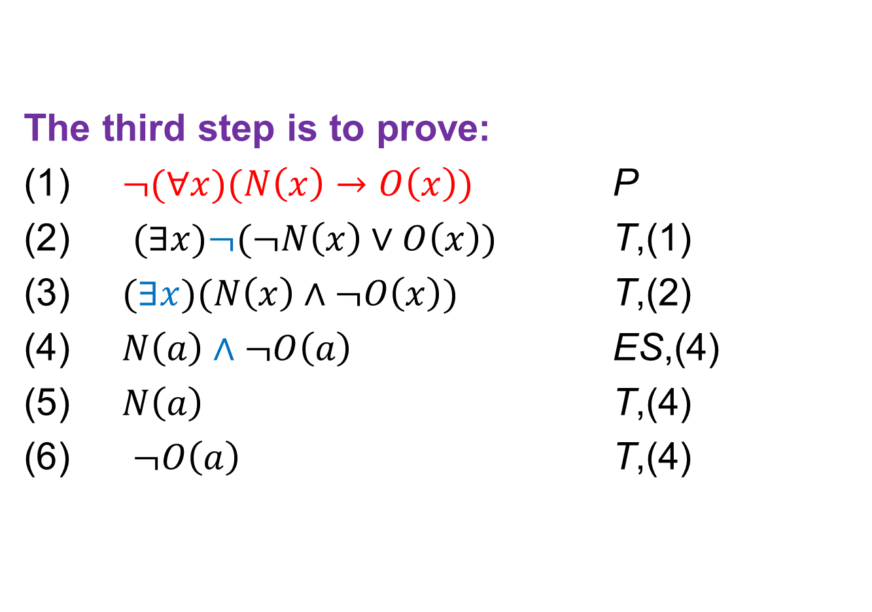
Predicate logic to solve real problems
推理规则
1. 约束变元的改名规则
2. 自由变元的代入规则
3. 命题变元的代换规则
4. 取代规则
5. 关于量词的增加和删除规则
US ES EG UG
推理实例
反证法
解决实际问题
The third step is to prove:
$¬(∀x)(N\left(x\right)→O\left(x\right))$ P
$(∃x)¬(¬N\left(x\right)∨O\left(x\right))$ T,(1)
$(∃x)(N\left(x\right)∧¬O\left(x\right))$ T,(2)
$N\left(a\right)∧¬O\left(a\right)$ ES,(4)
$N\left(a\right)$ T,(4)
$¬O\left(a\right)$ T,(4)

Slide 37
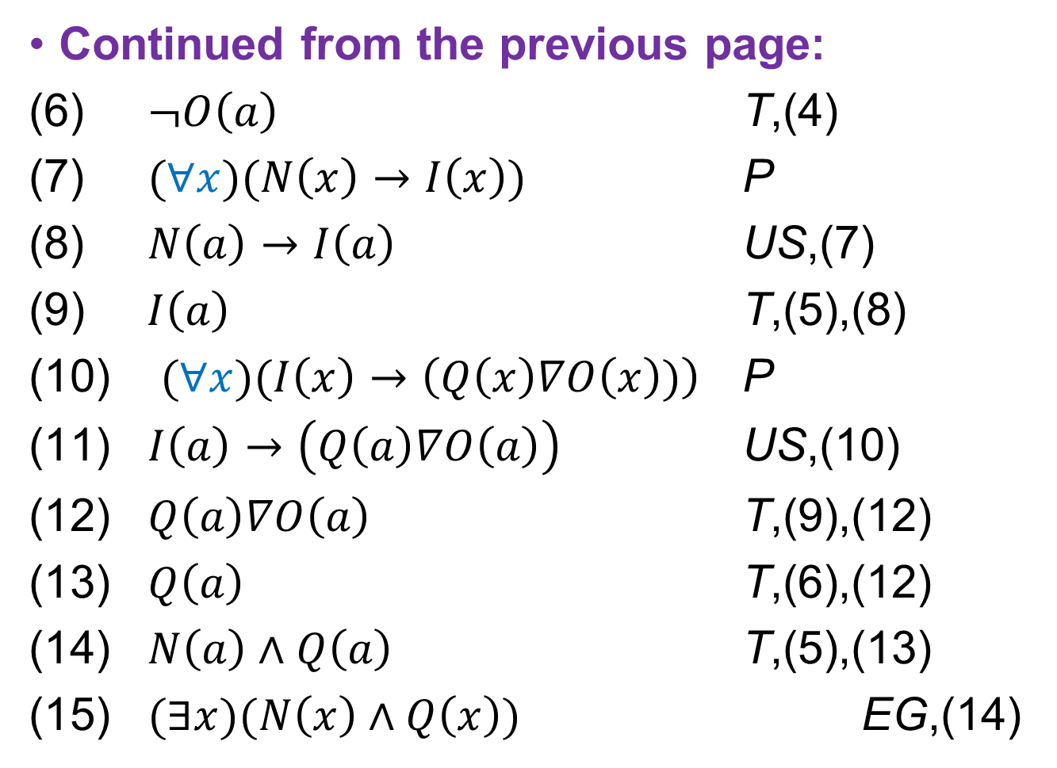
Predicate logic to solve real problems
推理规则
1. 约束变元的改名规则
2. 自由变元的代入规则
3. 命题变元的代换规则
4. 取代规则
5. 关于量词的增加和删除规则
US ES EG UG
推理实例
反证法
解决实际问题
Continued from the previous page:
(6) $¬O\left(a\right)$ T,(4)
(7) $(∀x)(N\left(x\right)→I\left(x\right))$ P
(8) $N\left(a\right)→I\left(a\right)$ US,(7)
$I\left(a\right)$ T,(5),(8)
$(∀x)(I\left(x\right)→\left(Q\left(x\right)∇O\left(x\right))\right)$ P
$I\left(a\right)→\left(Q\left(a\right)∇O\left(a\right)\right)$ US,(10)
$Q\left(a\right)∇O\left(a\right)$ T,(9),(12)
$Q\left(a\right)$ T,(6),(12)
$N\left(a\right)∧Q\left(a\right)$ T,(5),(13)
$(∃x)(N\left(x\right)∧Q\left(x\right))$ EG,(14)

Slide 38
Predicate logic to solve real problems
推理规则
1. 约束变元的改名规则
2. 自由变元的代入规则
3. 命题变元的代换规则
4. 取代规则
5. 关于量词的增加和删除规则
US ES EG UG
推理实例
反证法
解决实际问题
Example 10:
Each graduate student who is applying for a master degree either participates in the postgraduate entrance examination or is recommended as an exempt student;
For each graduate student that is applying for a master degree, he or she is recommended as an exempt student if and only if he or she has excellent academic performance;
Some graduates who are applying for master degrees have excellent academic performance, but not all graduates who are applying for master degrees have excellent academic performance.
Therefore, some graduates who are applying for master degrees are required to take the postgraduate entrance exam.
Solution: Define the predicates as follows:
YJS(x)：x is a graduate who wants to apply for a postgraduate degree;
MKS(x)： x is an exempt student ；
CJYX(x)： x has excellent academic performance；
CJKS(x)： x takes the exam.

Slide 39
Predicate logic to solve real problems
推理规则
1. 约束变元的改名规则
2. 自由变元的代入规则
3. 命题变元的代换规则
4. 取代规则
5. 关于量词的增加和删除规则
US ES EG UG
推理实例
反证法
解决实际问题
The second step, the symbolization problem:
Each graduate student who is applying for a master degree either participates in the postgraduate entrance examination or is recommended as an exempt student;
For each graduate student that is applying for a master degree, he or she is recommended as an exempt student if and only if he or she has excellent academic performance;
Some graduates who are applying for master degrees have excellent academic performance, but not all graduates who are applying for master degrees have excellent academic performance.
Therefore, some graduates who are applying for master degrees are required to take the postgraduate entrance exam.

Slide 40
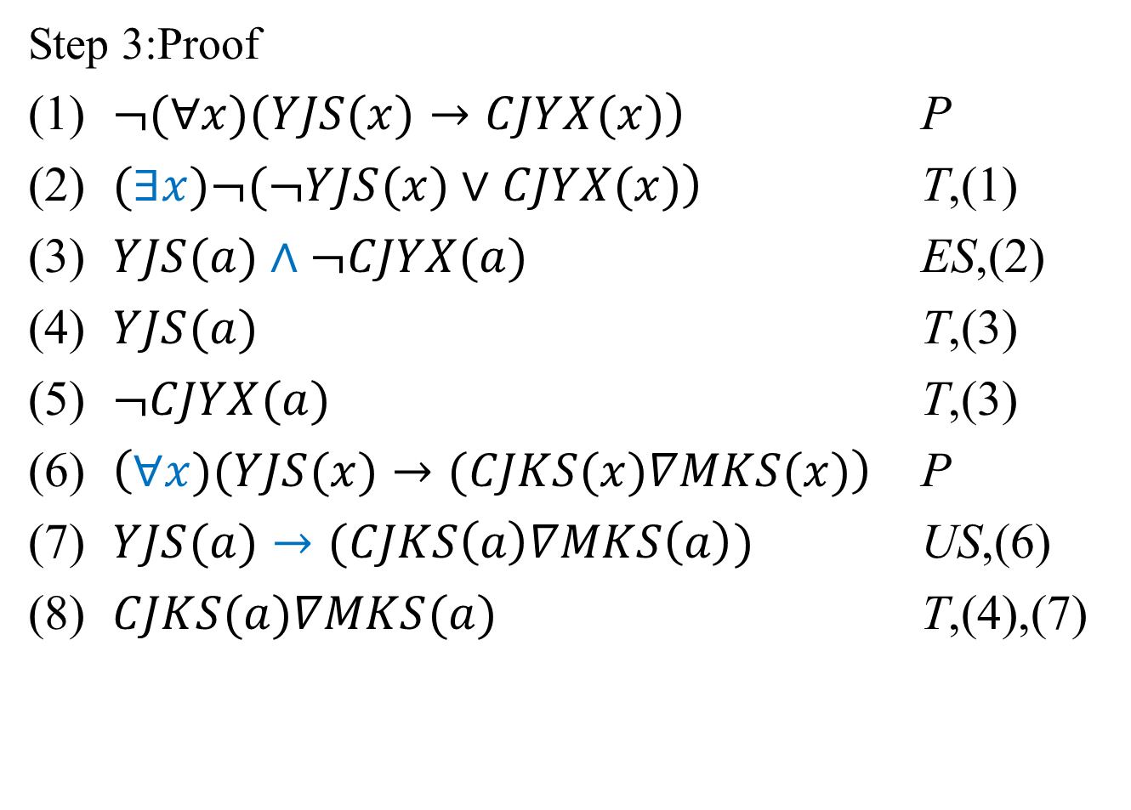
Predicate logic to solve real problems
推理规则
1. 约束变元的改名规则
2. 自由变元的代入规则
3. 命题变元的代换规则
4. 取代规则
5. 关于量词的增加和删除规则
US ES EG UG
推理实例
反证法
解决实际问题
Step 3:Proof
$\left.¬(∀x)(YJS(x)→CJYX(x)\right)$ P
$\left.(∃x)¬(¬YJS(x)∨CJYX(x)\right)$ T,(1)
$YJS(a)∧¬CJYX(a)$ ES,(2)
$YJS(a)$ T,(3)
$¬CJYX(a)$ T,(3)
$\left(∀x)(YJS(x)→(CJKS(x)∇MKS(x)\right)$ P
$YJS(a)→(CJKS\left(a\right)∇MKS\left(a\right))$ US,(6)
$CJKS(a)∇MKS(a)$ T,(4),(7)

Slide 41
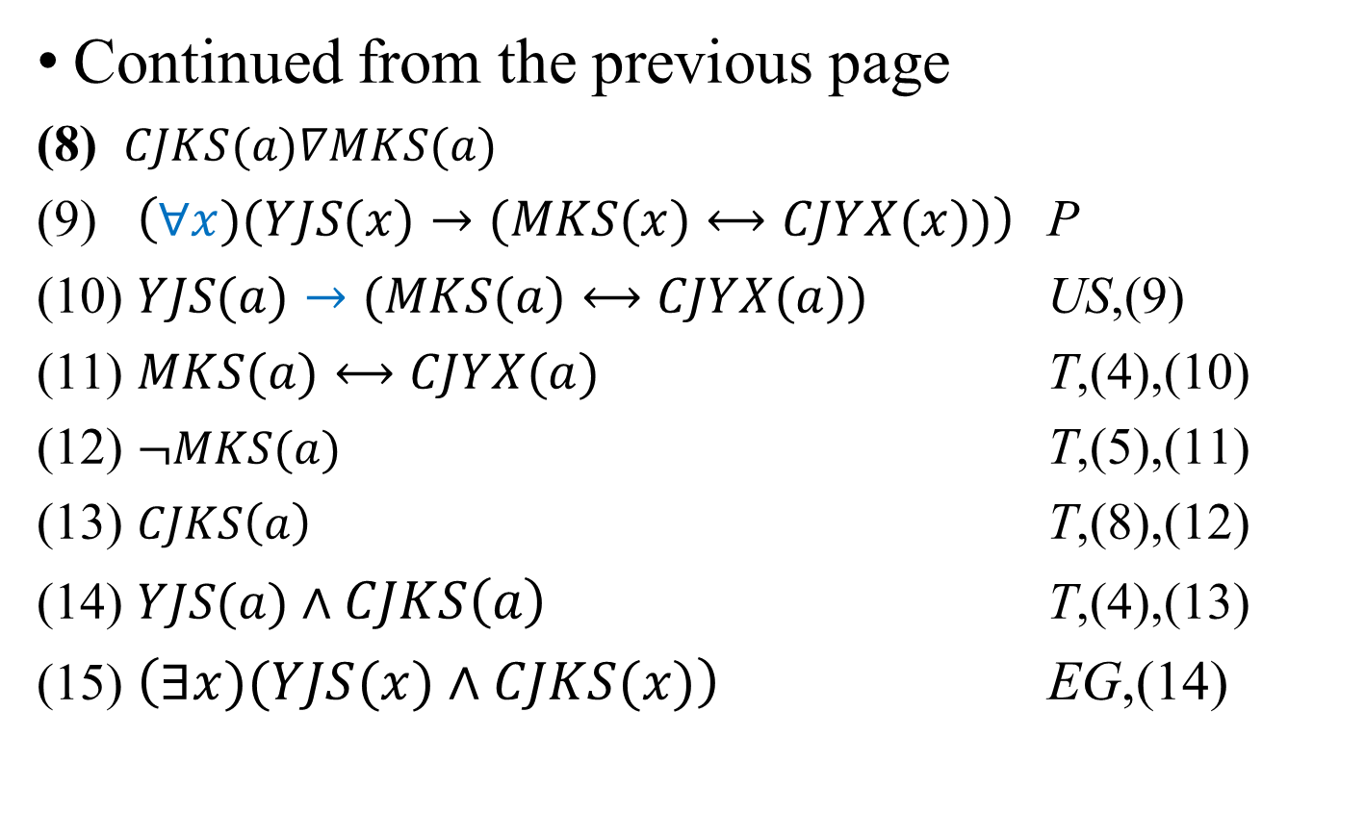
Predicate logic to solve real problems
推理规则
1. 约束变元的改名规则
2. 自由变元的代入规则
3. 命题变元的代换规则
4. 取代规则
5. 关于量词的增加和删除规则
US ES EG UG
推理实例
反证法
解决实际问题
Continued from the previous page
(8) $CJKS(a)∇MKS(a)$
(9) $\left(∀x)(YJS(x)→(MKS(x)⟷CJYX(x))\right)$ P
(10) $YJS(a)→(MKS(a)⟷CJYX(a))$ US,(9)
(11) $MKS(a)⟷CJYX(a)$ T,(4),(10)
(12) $¬MKS(a)$ T,(5),(11)
(13) $CJKS\left(a\right)$ T,(8),(12)
(14) $YJS(a)∧CJKS\left(a\right)$ T,(4),(13)
(15) $\left(∃x)(YJS(x)∧CJKS(x)\right)$ EG,(14)

Slide 42
Predicate logic to solve real problems
推理规则
1. 约束变元的改名规则
2. 自由变元的代入规则
3. 命题变元的代换规则
4. 取代规则
5. 关于量词的增加和删除规则
US ES EG UG
推理实例
反证法
解决实际问题
Example 11: All hummingbirds (蜂鸟) are richly colored; no large birds live on honey; birds that do not live on honey are dull in color（色彩单调的）; therefore, hummingbirds are small.
Solution: Define the predicate as follows:
P(x) : x is a hummingbird;
Q(x): x is large;
R(x): x is a bird that lives on honey;
S(x): x is richly colored.

Slide 43
Predicate logic to solve real problems
推理规则
1. 约束变元的改名规则
2. 自由变元的代入规则
3. 命题变元的代换规则
4. 取代规则
5. 关于量词的增加和删除规则
US ES EG UG
推理实例
反证法
解决实际问题
(∀x)(P(x) → S(x)), ¬(∃x)(Q(x) ∧R(x))，(∀x)(¬R(x) → ¬S(x)) ⇒ (∀x)(P(x) → ¬Q(x))
Proof:
(1) (∀x)(P(x) → S(x)) P
(2) P(x) → S(x) US, (1)
(3) (∀x)(¬R(x) → ¬S(x)) P
(4) ¬R(x) → ¬S(x) US, (3)
(5) S(x) → R(x) T, (4)
(6) ¬(∃x)(Q(x) ∧R(x)) P
(7) (∀x)(¬Q(x) ∨ ¬R(x)) T, (6)
(8) ¬Q(x) ∨ ¬R(x) US, (7)
(9) R(x) → ¬Q(x) T, (8)
(10) P(x) → R(x) T, (2), (5)
(11) P(x) → ¬Q(x) T, (9), (10)
(12) (∀x)(P(x) → ¬Q(x)) UG, (11)

Slide 44
Practice in the classroom
Exercise: Express the following propositions and use inference rules to argue the conclusions.
All cattles have horns, some animals are cattles, so some animals have horns.

Slide 45
Summarization
Tips
Rules of Inference for Predicate Logic
UG------- Universal Generalization
EG------- Existential Generalization
US------- Universal Specialization
ES------- Existential Specialization
Predicate logic to solve real problems

Slide 46
Homework
P48
3
4 (2, 4)
5
6 (2, 4)
8
9 (1)

Slide 47
Up Next …
Next Lecture
Inference for Predicate Logic
Rules of Inference

Slide 48

The End
Thanks

